Slide 1



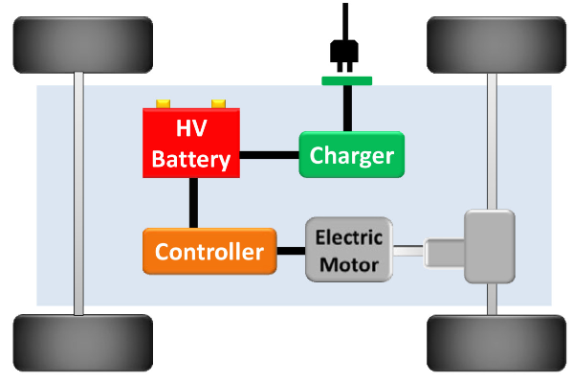
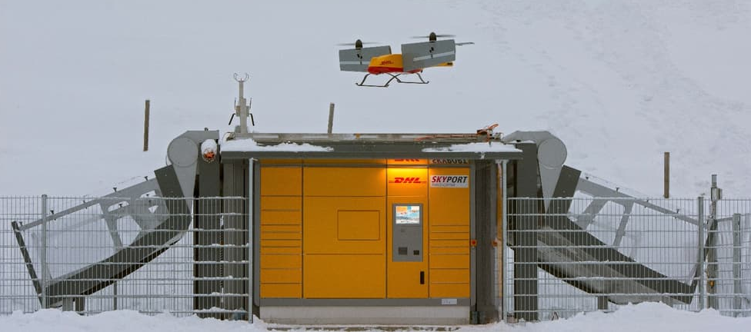

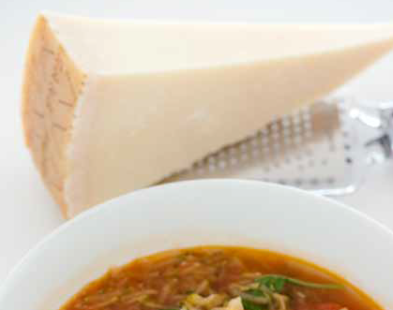
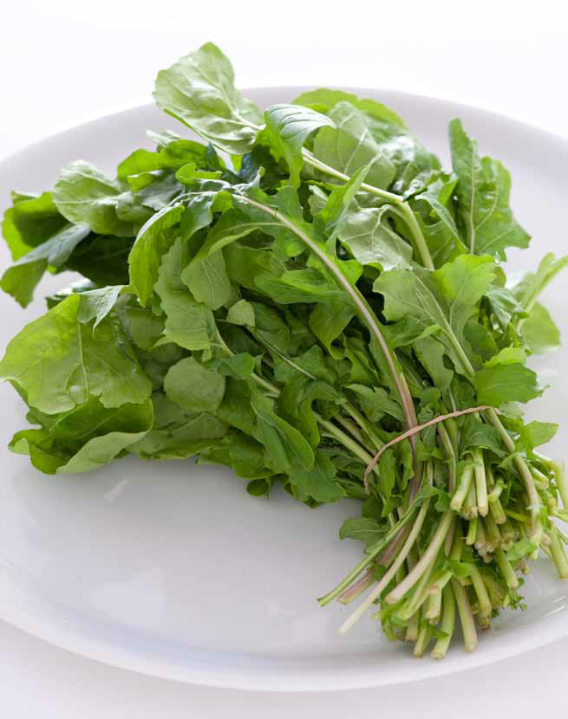
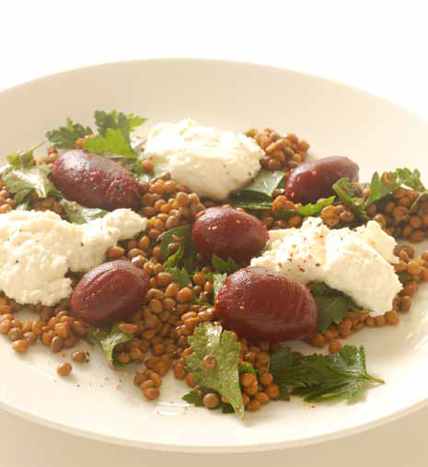
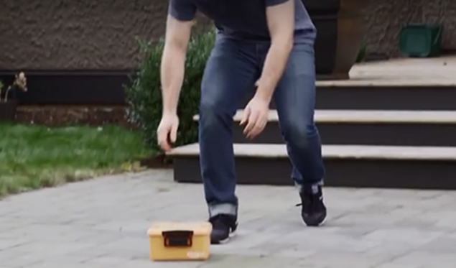
5TH WORKSHOP ON APPLIED
AND SUSTAINABLE ENGINEERING
01.06.2020 to 05.06.2020, Koszalin University of Technology, Poland
DEVELOPMENT OF CAR TECHNOLOGIES
Nowak J., Lisek L., Faculty of Mechanical Engineering, Koszalin University of Technology, Poland
SUMMARY
The examples of the practicability of today's BEV is discussed, revealing that particularly small-size BEVs are useful. This article reports on an e-conversion of a used Smart. Measurements on this car, prior and after conversion, confirmed a fourfold energy efficiency advantage of BEV over ICEV, as supposed in literature
INTRODUCTION
The popular name this puree is a quick and easy starter to serve with warm pita bread or your favourite dipping vehicle. Another option is to serve it on crostini - thin slices of baguette that have been toasted on one side and rubbed with a cut clove of garlic while still hot [4].
There is becoming increasingly common feel free to use whichever white beans you prefer. Canellini, butter beans, borlotti or even fava would all work. I’m also thinking that chickpeas would be lovely but haven’t tried them out yet. The choice of cheese is in your court. The mayo makes it a bit moister so you could easily use hard cheese such as parmesan or manchengo. For me right now, Irish cheddar is where it’s at.
The transport of goods Laksa is a wonderful coconut milk based noodle soup that hails from Malaysia. These days you can get commercial laska or other Thai curry pastes that take all the hard work out of it. I’ve used Singapore noodles in this recipe which are a fine version of fresh hokkien noodles but I have eaten laksa with rice noodles and even a combination of the two so feel free to substitute.
The project Meanwhile heat 2 tablespoons of peanut or other vegetable oil in a large saucepan over high heat. Quickly add coconut cream and 2 cups boiling water. Bring to the boil and add vegetables. Simmer for 2 minutes or until the vegetables are cooked to your liking, (Fig . 2).
Fig. 2. DHL – Parcelcopter [2]
The problem with using drones to deliver foot are:
- legal restrictions due to the safety of people [5],
- protection against taking delivery by unauthorized persons,
- systems that allow collision-free reach milk to the place of delivery
Fig. 3. Plates Skyport [2]
CONCLUSION
Legal restrictions may result that beans foot will be developed in countries where the law governing their use is lax, or where there is no such right .
In future, safe use of milk for forwarding shipments requires manufacturers of this equipment to improve the quality of equipment and the creation of plates indestructible, with a large safety margin, not susceptible to the influence of weather factors such as temperature changes, frost, rain and humidity and wind drift. Such works have already been implemented [6]. However, they do not offer enough power and have a worse environmental impact compared to Li-ion batteries (see below). The only alternative to Li-ion batteries with comparable power, the Zebra cell [7]. This system include among others infrared sensors, cameras, high-resolution laser and infrared light. These devices and software allow for 3 D space to "see " the environment and record the movements of objects located there.
Security BEV of mobility expected for the future, the reduction of automobile energy demand is one of the most important challenges. In order to evaluate the technologies available, energy consumption is divided into the well-to-tank [8].
LITERATURE
Rokosz K., Simon F., Hryniewicza T., Rzadkiewicz S., Comparative XPS analysis of passive layers composition formed on AISI 304 L SS after standard and high-current density electropolishing, Surface and Interface Analysis, 47(1), 2015, 87-92.
Milhouse M., Framework for Autonomous Movement of Drones. Illinois Institute of Technology. RIIT '15, Proceedings of the 4th Annual ACM Conference on Research in Information Technology, 2015, 1- 4.
http://www.dhl.com
http://www.amazon.com/b?node=8037720011
http://www.amazon.com/b?node=8037720011
http://www.amazon.com/b?node=8037720011
http://www.amazon.com/b?node=8037720011
http://www.amazon.com/b?node=8037720011
Fig. 1. Ordered goods - preparation and delivery to the customer [1]

